Slide 1
Introduction to Java Servlet

Slide 2
Overview of Application Server
For hosting template text / static pages / hard coded (html) and server side application (cgi / servlet)
Most of the time integrated with a simple web-server
Can be plugged to a more powerful web-server
Ranging from million of dollars in pricing to the open source project which is free

Slide 3
Overview of Application Server
Existing application server in the market
  Apache TOMCAT
  Xampp
  WAMP
  LAMP
  Jboss
  GlassFish

Slide 4
What is Servlet
a web component,
managed by a container (Application Server),
generates dynamic content. (HTML TAG)
  serving a different page according to client data submitted via a form
  Or a GET method
small, platform independent Java classes compiled to a bytecode that can be loaded dynamically into and run by a web server.
interact with web clients via a request response paradigm implemented by the servlet container.
request-response model is based on the behavior of the Hypertext Transfer Protocol (HTTP).

Slide 5
Servlet Tasks
Read sent user data –
  via form (POST protocol) or
  embedded URL (GET protocol)
Look up info on http request – usually form/POST data or URL/GET data
Generate result (connect to db etc.),
Format the html result
Set the appropriate http response parameters – set content type html/text etc.
Send document (HTML page) back to client browser

Slide 6
Client Interaction
When a servlet accepts a call from a client, it receives two objects:
A ServletRequest, which encapsulates the communication from the client to the server. – getParameter()
A ServletResponse, which encapsulates the communication from the servlet back to the client – out.println()
ServletRequest and ServletResponse are interfaces defined by the javax.servlet package

Slide 7
Request & Response Overview
Class loader
No
Invoker
1 HTTP request
2
yes
Is servlet loaded?
2
3
service
thread
4
5 HTTP response
Browser
(WWW client)
Application Server / HTTP SERVER
(Server)

Slide 8
Normal Servlet Operation
extends HttpServlet interface
implement one or more service methods
  doGet, doPost, etc
Setting the content type
Data processing
Formatting presentation HTML
Returning a response

Slide 9
Intro to Netbeans - HelloWorld servlet
<IMG> tag
<A> tag
<TABLE> tag

Slide 10
Data Transmission
there are two ways on how browser can send data to a servlet via HTTP protocol
  GET method
  POST method

Slide 11
GET method
The body of the message (the data) is appended to the servlet URL,
  http://localhost/servlet/HelloWorld
Separated by a question mark
  http://localhost/servlet/HelloWorld?
Followed by name-value pair which separated by equals sign
If value consist of more than one word, separate it using plus sign which the servlet will convert it to space character after parsing
  name=rosely+kumoi
Every consecutive name-value pair will be separated using ampersand sign (&)
  name=rosely+kumoi&ic=h0803907

Slide 12
Hello Get
Sum / Sum Oper GET
Table GET

Slide 13
POST method
The body of the message is sent as a stream of data (HTML form data)
Separated with the servlet URL
Client send data to servlet using HTML form element

Slide 14
HTML Form element
Form tag
    <FORM METHOD=”post”
      ACTION=”/servlet/HelloWorld”
      TARGET=”frameName”>
Fill the TARGET value if form result have to display in a different frame
After coding all the form element (button, textfield, etc) FORM tag must be close using the equivalent end tag - </FORM>
If you have multiple form in a single page every separate every form using the end tag

Slide 15
HTML Form element
Textfield element
  Single line textbox
  Code example:
    <INPUT NAME="name" TYPE="text" SIZE="25">
Password element
  Single line textbox - actual text hidden
  Code example:
    <INPUT NAME="password" TYPE="password" SIZE="25">
TextArea element
  Multiline textbox
  Code example:
    <TEXTAREA NAME="address" ROWS="5" COLS="23"></TEXTAREA>

Slide 16
HTML Form element
Combo Box
    Single item selection permitted
    <SELECT NAME=”creditCardType”>
    <OPTION SELECTED VALUE=”mc”>MasterCard
    <OPTION VALUE=”visa”>VISA
    <OPTION VALUE=”amex”>American Express
    </SELECT>
List Box
    Multiple item selection permitted
    <SELECT NAME=”language” MULTIPLE>
    <OPTION SELECTED VALUE=”c”>C
    <OPTION VALUE=”c++”>C++
    <OPTION VALUE=”java”>Java
    </SELECT>

Slide 17
HTML Form element
Radio Button
Only one item selection permitted
<INPUT TYPE="RADIO" NAME="creditCard"
VALUE="mc" CHECKED>MasterCard
<INPUT TYPE="RADIO" NAME="creditCard"
VALUE="visa">VISA
<INPUT TYPE="RADIO" NAME="creditCard"
VALUE="amex">American Express

Slide 18
HTML Form element
CheckBox
  Name & Value attribute are only sent to the server (servlet) if the check box is checked
  Usually servlet/CGI programs often check only for the existence of the checkbox name, ignoring its value
  Multiple item selection permitted
<P>
<INPUT TYPE="CHECKBOX" NAME="mailMe" CHECKED>
Check here if you want to get our email newsletter

Slide 19
HTML Form element
Push Buttons
  Submit Buttons
  <INPUT NAME="name" TYPE="submit"
  VALUE="Submit">
  Change value of attribute VALUE if you want to change the button label
  Reset Buttons
  <INPUT NAME="name" TYPE="reset"
  VALUE="Reset">

Slide 20
HTML FORM ATTRIBUTE
required – compulsory field
value – default value
readonly – cannot change value but value will be sent to servlet
disabled - unusable and un-clickable, and its value will not be sent to servlet
size – textfield size
maxlength - specifies the maximum allowed length for the input field

Slide 21
Form Servlet
Calc POST

Slide 22
Java Database Connectivity - JDBC API
Java API for accessing virtually any kind of tabular data
Consists of
  a set of classes and interfaces
  written in the Java programming language that
  provide a standard API for tool/database developers
Guarantee that an application can access virtually any data source and run on any platform with a Java Virtual Machine

Slide 23
4 types of JDBC Driver
JDBC-ODBC Bridge plus ODBC driver
  provides JDBC access via ODBC drivers
  Windows platform only
  Cannot be used directly from browser (HTTP protocol)
  Can be solved by using a middleware such as RMI / CORBA
Native-API partly-Java driver
  driver converts JDBC calls into calls on the client API
  requires that some operating system-specific binary code be loaded on each client machine

Slide 24
4 types of JDBC Driver
JDBC-Net pure Java driver
  driver translates JDBC calls into a DBMS-independent net protocol,
  act as middleware server
  able to connect its pure Java clients to many different databases - the most flexible JDBC alternative
Native-protocol pure Java driver
  converts JDBC calls directly into the network protocol used by DBMS
  This allows a direct call from the client machine to the DBMS server - perfect for Internet JDBC access
  available only by DBMS vendor - Oracle, Sybase etc.

Slide 25
Using JDBC
Install Java and JDBC API on your machine – JDBC preinstalled with JDK (standard API)
Install a JDBC driver on your machine. – Usually DMBS comes with its own JDBC driver
  JDBC-ODBC driver pre-installed with the JDK
Install your DBMS if needed (connection can also be done in remote)
Setting Up a Database – creating table, relationships etc.
Establishing a Connection
  For selecting, adding, modifying and deleting
  Closing connection

Slide 26
Prepared SQL
For each SQL statement received, the DB builds a query plan by
  parsing the SQL statement
  reading the SQL to determine what to do
  formulating a plan for executing the SQL
Repeatedly executing SQL with same query plan is very inefficient

Slide 27
Prepared SQL (contd.)
DBs enable you to optimize repeated calls through prepared SQL.
Create a Java instance of a prepared statement that notifies the DB of the kind of SQL call it represents.
DB can then create a query plan for that SQL even before it is actually executed.
If the same prepared statement is executed more than once, the DB uses the same query plan without rebuilding a new one.

Slide 28

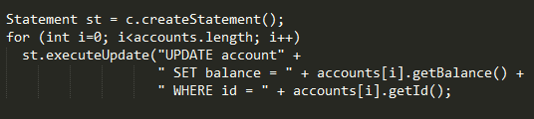
Normal SQL – query planning is repeating each time SQL executed

Slide 29
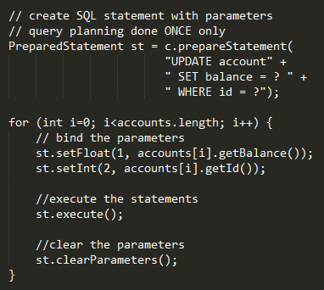
Using prepared statements
Query planning done once
Statement can be executed repeatedly

Slide 30
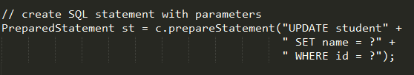
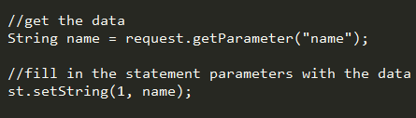
Prepared statement operations
Prepare the statement
Fill in the statement parameters with data
Execute the statement
Process the result if there is any

Slide 31
Prepared statement operations
Operation 1 do ONCE ONLY!
Operation 2, 3 and 4 can be repeated indefinitely using the prepared statements in 1

Slide 32
Installing database
We are using mysql database
Download xampp and install
Open phpmyadmin
Import sql (use the one from dropbox)

Slide 33
Netbeans JDBC project connect to mysql database
Create new Java Web project
Using windows explorer locate the project folder
Create lib folder in the project folder
Download mysql-connector-java-X.X.X.X-bin.jar
  From https://dev.mysql.com/downloads/connector/j/
  From dropbox
Copy the jar files in the lib folder (task 3)
Right click Libraries in the netbeans project:
  choose Add Jar/Folder …
  Add the mysql-connector-java from the lib folder (task 5)

Slide 34
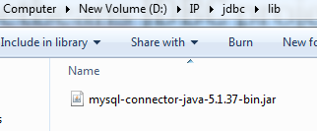
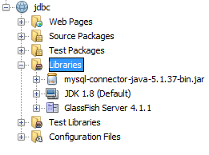
Netbeans JDBC project connect to mysql database

Slide 35
Custom JDBC class - JDBCUtility
A constructor database connection details
  public JDBCUtility(String driver,
  String url,
  String userName,
  String password)
  {
  this.driver = driver;
  this.url = url;
  this.userName = userName;
  this.password = password;
  }

Slide 36
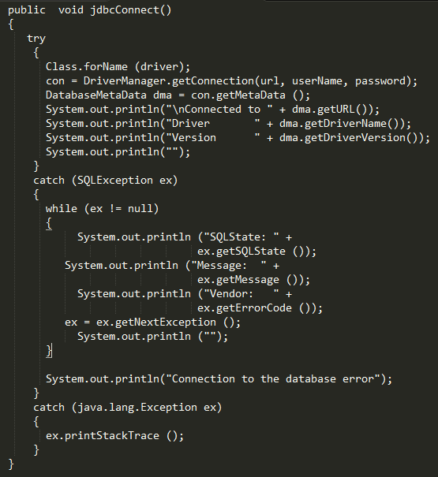
Custom JDBC class - JDBCUtility
A method for initiating connection to the database

Slide 37
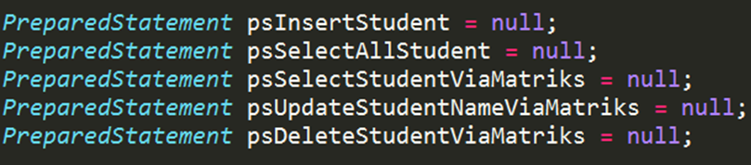
JDBC – initial data
Create variables for representing all the prepared statements needed

Slide 38
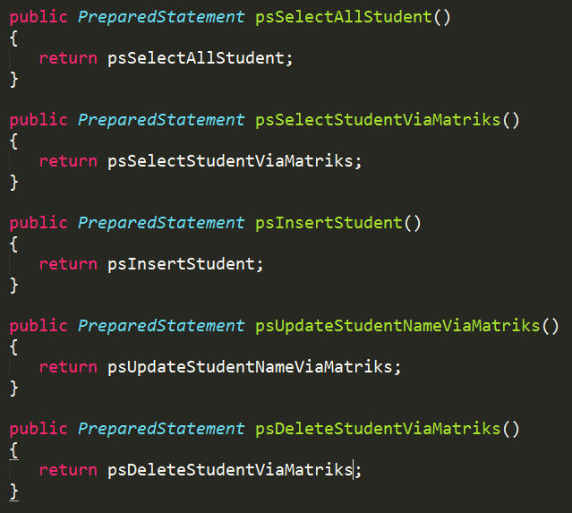
Prepared Statement - get method to use the statement in servlet for later

Slide 39
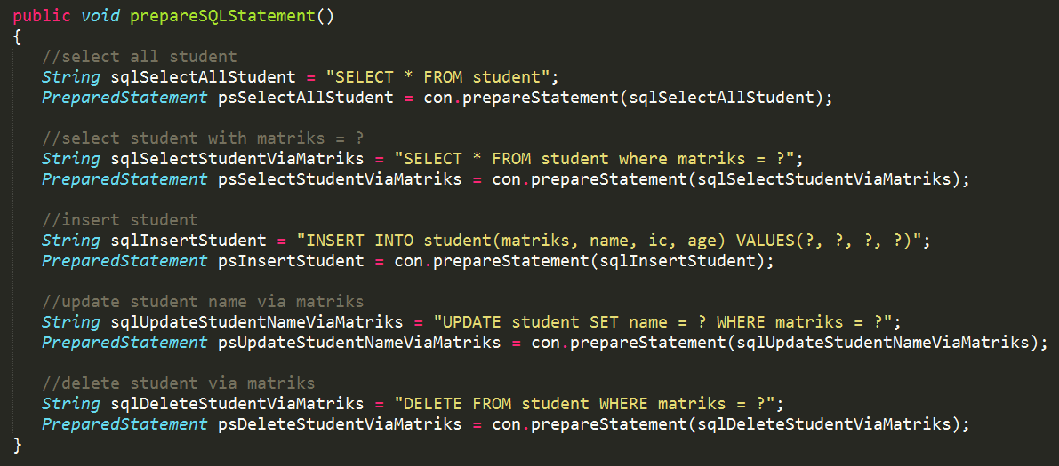
JDBC – method to execute the preparing statements operation – ONCE ONLY!

Slide 40
Using the JDBC in servlet
Create global variables in servlet
  private JDBCUtility jdbcUtility;
  private Connection con;
In init method (THIS METHOD WILL BE CALLED ONCE ONLY – refer slide 11)
    Call the constructor to instantiate the JDBCUtility object
    Call the connect method to initiate connection to the database
      jdbcUtility.jdbcConnect();
    Get a working connection
      con = jdbcUtility.jdbcGetConnection();
    Execute the preparing of statements operation
      jdbcUtility.prepareSQLStatement();

Slide 41
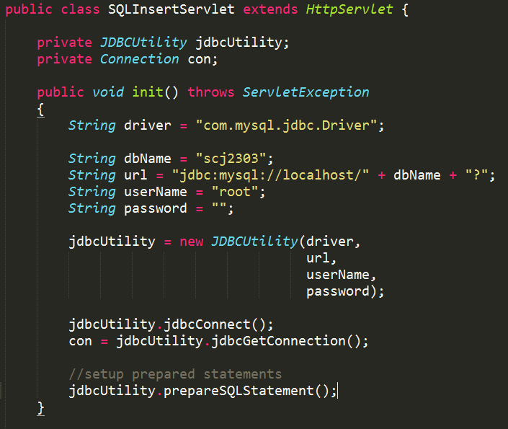

Slide 42
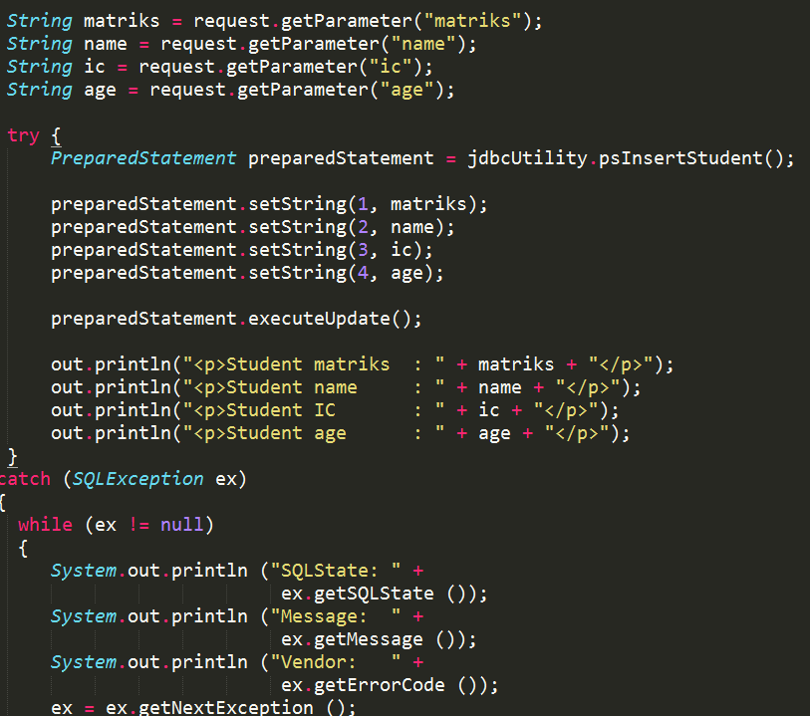
Get the prepared statement needed, fill the data and execute

Slide 43
JDBC project
INSERT record
  Run the project – (running the index.html)
    Will display the form
    Form action directed to DBInsertStudent servlet
SELECT all record (view in table)
  Run the servlet: DBSelect
UPDATE record
  Must select the record first using the primary key
    Servlet name: DBUpdateForm
    GET method data: matriks
  Put the record into form
  Form action directed to DBUpdateStudent servlet

Slide 44
JDBC project
DELETE record
  Servlet name: DBDeleteStudentViaMatriks
  GET method data: matriks
DBDataTable
  CRUD operations
    C-reate – SQL INSERT operation (DBInsertStudent servlet)
    R-ead – SQL SELECT operation (DBSelect servlet)
    U-pdate – SQL UPDATE operation (DBUpdateStudent servlet)
    D-elete – SQL DELETE operation (DBDeleteStudentViaMatriks servlet)
  All operations in one single page

Slide 45
Persistent State in HTTP Servlets
HTTP transactions are made in isolation of one another
  do not have a mechanism for keeping track of a request or request data sent using a web browser
  said to be “stateless”
Benefit
  Client browsers do not notice when a server goes down and comes up quickly
Drawback
  difficult to produce groups of pages for collecting information to produce picture of the user’s web experience

Slide 46
Session tracking methods
Cookies (netbeans example: cookies / cookiesshare
  small size of information left by the server at client machine (in browser cookies repository)
  misinformation about cookies
    Never interpreted or executed
    browsers generally only accept 20 cookies per site
    and 300 cookies and limited to 4 kilobytes per size
    cannot be used to fill up someone’s disk or launch other denial of service attack
  problem
    user disable browser cookies
      to protect privacy

Slide 47
Session tracking methods
URL Rewriting.
  append some extra data on the end of each URL that identifies the session, and the server associate that session identifier with data it has stored about that session.
  Excellent solution with browsers that don't support cookies or where the user has disabled cookies.
  However, it has most of the same problems as cookies, namely that the server-side program has a lot of straightforward but tedious processing to do.
  In addition, you have to be very careful if the user leaves the session and comes back via a bookmark or link, the session information can be lost.

Slide 48
Session tracking methods
Hidden form fields.
  HTML forms have an entry that looks like the following:
  <INPUT TYPE="HIDDEN" NAME="session" VALUE="...">
  This means that, when the form is submitted, the specified name and value are included in the GET or POST data.
  This can be used to store information about the session.
  However, it has the major disadvantage that it only works if every page is dynamically generated, since the whole point is that each session has a unique identifier.
  Netbeans example: hidden

Slide 49
Session management in Servlet
HttpSession API.
  high-level interface built on top of cookies or URL-rewriting.
  use cookies if the browser supports them,
  automatically revert to URL-rewriting when cookies are unsupported or explicitly disabled.
  servlet author doesn't need to bother with many of the details,
    doesn't have to explicitly manipulate cookies
    or information appended to the URL,
    automatically given a convenient place to store data that is associated with each session.

Slide 50
HttpSession API
Provides a way to identify a user across more than one page request
create a session between an HTTP client and an HTTP server.
session persists for a specified time period, across more than one connection or page request from the user.
usually corresponds to one user
allows servlet to
  View and manipulate information about a session, such as the session identifier, creation time, and last accessed time
  Bind objects to sessions, allowing user information to persist across multiple user connections

Slide 51
HttpSession API
Looking up the session object associated with the current request,
    HttpSession session = request.getSession();
      Returns the current session associated with this request, or if the request does not have a session, creates one.
    HttpSession session = request.getSession(boolean param);
      param=true - to create a new session for this request if necessary;
      param=false to return null if there's no current session

Slide 52
HttpSession API
Binds an object to this session, using the name specified.
If an object of the same name is already bound to the session, the object is replaced
  void setAttribute(java.lang.String name, java.lang.Object value)
Returns the object bound with the specified name in this session, or null if no object is bound under the name
  java.lang.Object getAttribute(java.lang.String name)

Slide 53
HttpSession API
Specifies the time, in seconds, between client requests before the servlet container will invalidate this session. A negative time indicates the session should never timeout.
  void setMaxInactiveInterval(int interval)
    interval in seconds
    default 30 minutes
Invalidates this session and unbinds any objects bound to it (remove current session)
  void invalidate()

Slide 54
Session

Slide 55
JavaBeans Technology
A JavaBean component is a reusable software component that uses a standard "method" naming convention.
This gives JavaBean components predictable behavior and makes tool-based manipulation easy.
The public features of JavaBeans components are properties, methods, and events.
NOTES: For JSP-Servlet operation, only the properties component of the JavaBeans will be used

Slide 56
JavaBeans Technology
One use of JavaBeans components is as a data encapsulator.
  A property of a JavaBean is simply the data (state) of the bean.
  Properties are accessible by two methods: the getter and the setter.
  The value of the property is accessed by the getter method.
  If the property is writable, its value is changed by the setter method.
  Any Java objects are permitted to be a property of JavaBeans

Slide 57
Bean
SessionServlet (page protection)

